Slide 1

By: Carlos Concepcion
Super Security Solutions

Slide 2
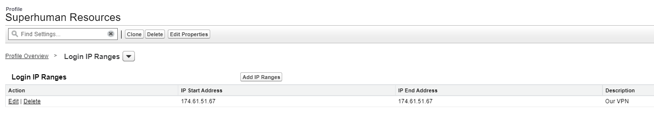
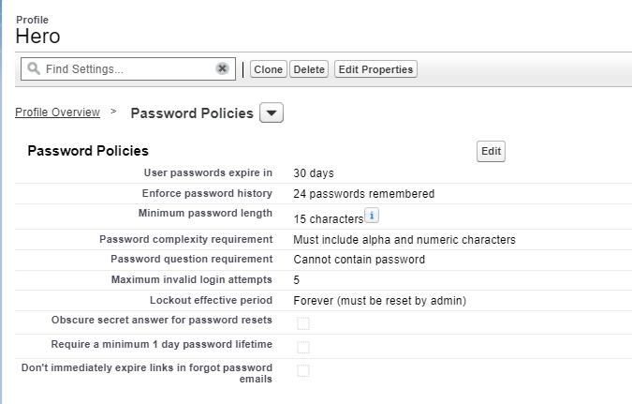
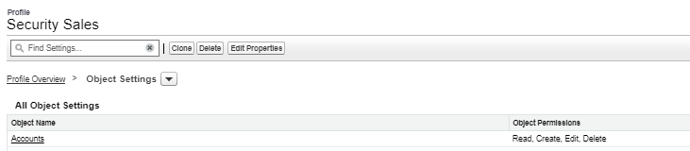
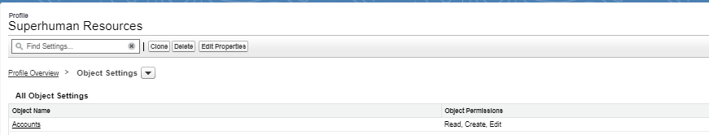
Security
Org-Level:
Object-level:

Slide 3
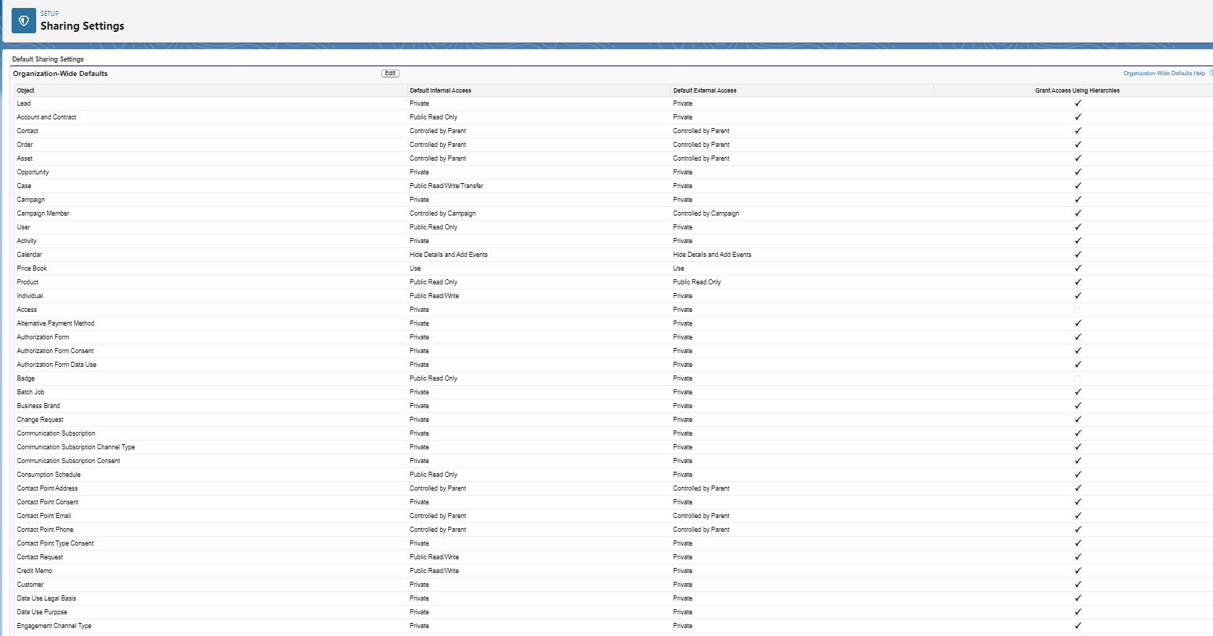
Record-Level Security

Slide 4
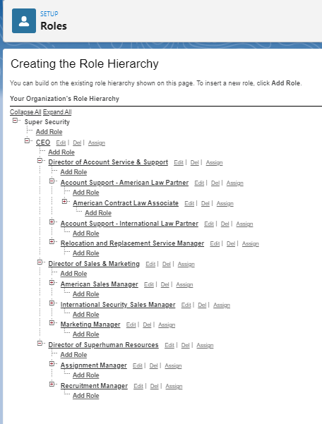
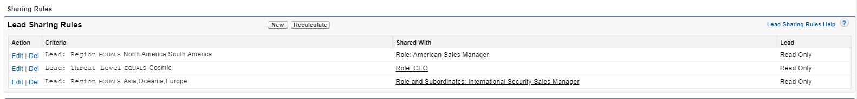
Record-level Security
Role and Role Hierarchy:
Sharing Rules:
Manual Sharing:

Slide 5
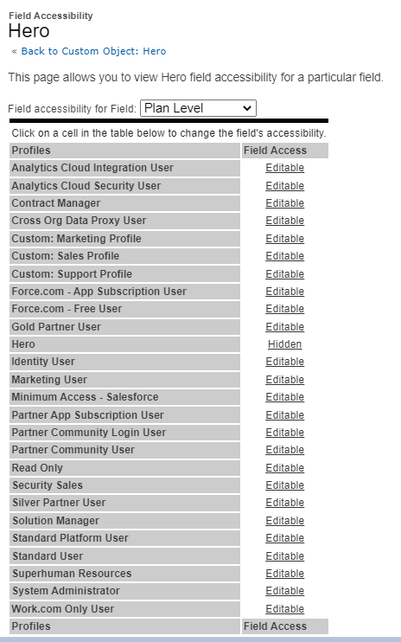

Field-Level Security
Most granular level

